Slide 1
Data Mining
Ch 8/9: Classification – 2
Examples of Bayesian Networks
Wan D. Bae, Ph.D.
baewd@hanyang.ac.kr

Slide 2
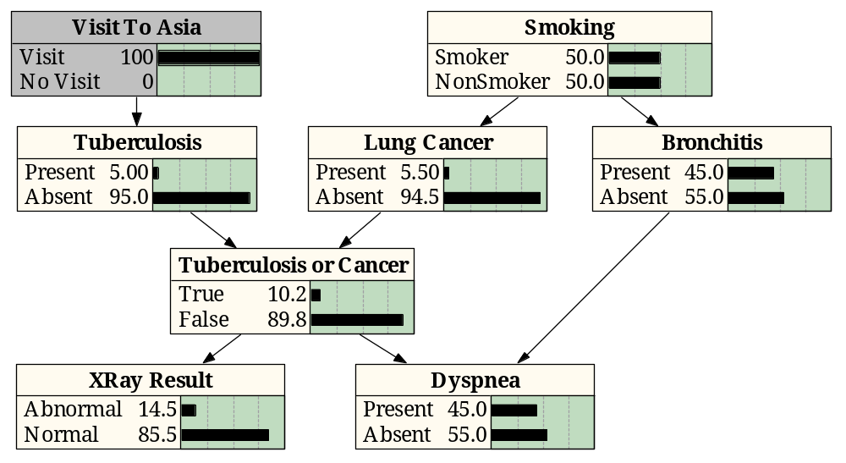
Example from Medical Diagnostics
As a finding is entered, the propagation algorithm updates the beliefs attached to each relevant node in the network
Interviewing the patient produces the information that “Visit to Asia” is “Visit”
This finding propagates through the network and the belief functions of several nodes are updated

Slide 3
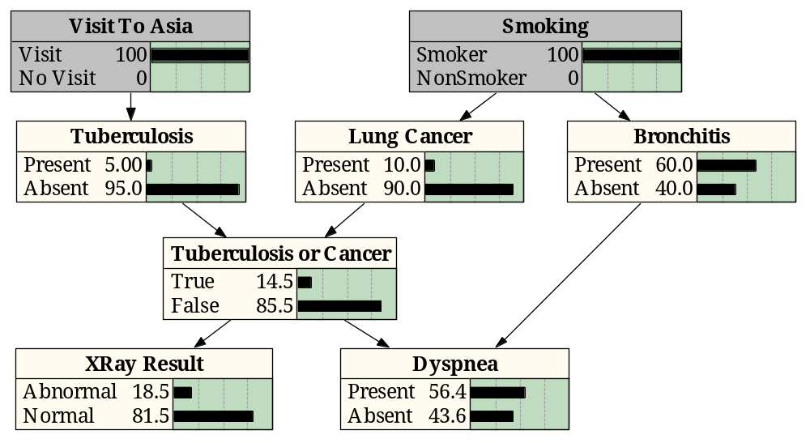
Example from Medical Diagnostics
Further interviewing of the patient produces the finding “Smoking” is “Smoker”
This information propagates through the network

Slide 4
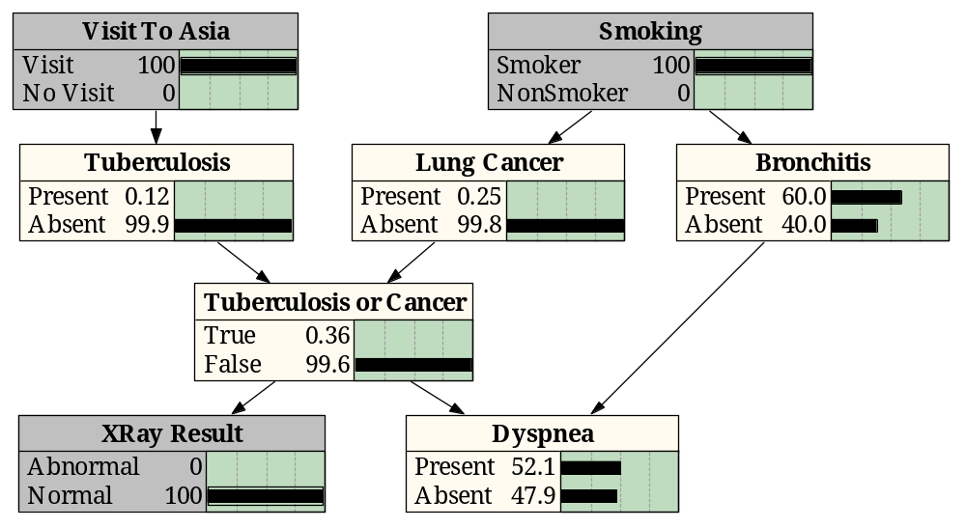
Example from Medical Diagnostics
Finished with interviewing the patient, the physician begins the examination
The physician now moves to specific diagnostic tests such as an X-Ray, which results in a “Normal” finding which propagates through the network
Note that the information from this finding propagates backward and forward through the arcs

Slide 5
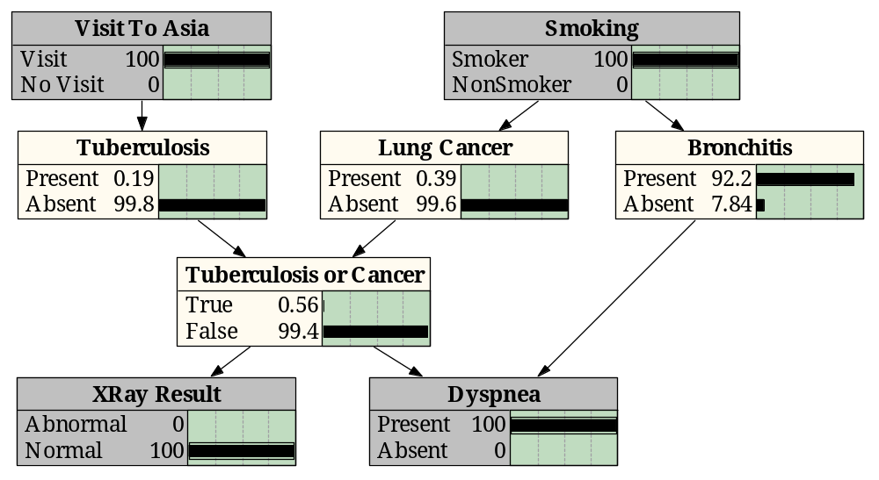
Example from Medical Diagnostics
The physician also determines that the patient is having difficulty breathing, the finding “Present” is entered for “Dyspnea” and is propagated through the network
The doctor might now conclude that the patient has bronchitis and does not have tuberculosis or lung cancer

Slide 6
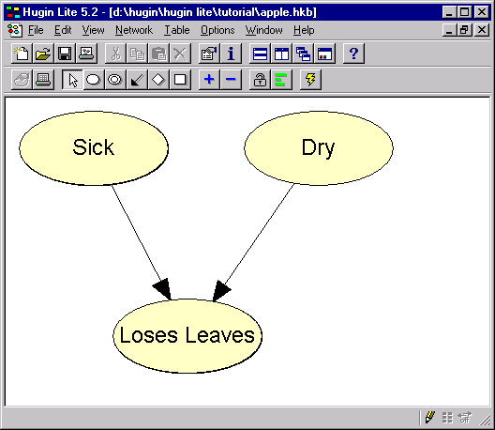
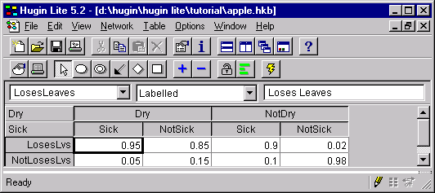
A Simple Bayesian Network
p(Sick) = 0.1
p(NotSick)=0.9
p(Dry) = 0.1
p(NotDry) =0.9
p(LosesLvs |Dry,Sick)=0.95
p(NotLosesLvs |Dry,Sick)=0.05
p(Losesvs |Dry, NotSick)=0.85
p(NotLosesLvs |Dry, NotSick)=0.15

Slide 7
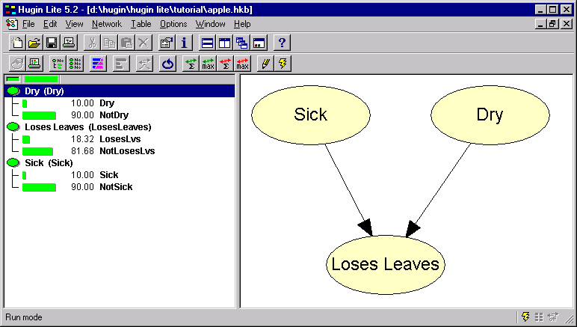
Initial Situation

Slide 8
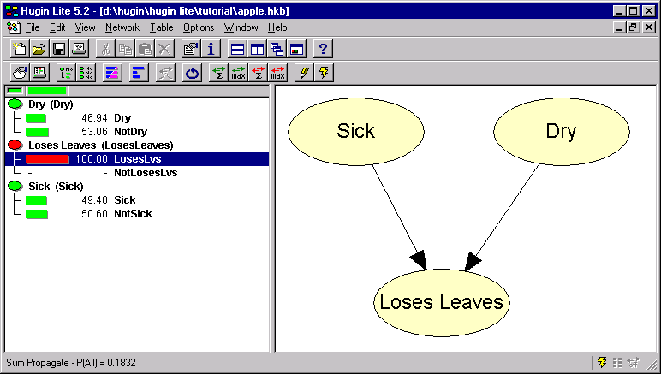
Probability of ‘Looses Leaves’ set to 100%
Probability of Dry and Sick about equal

Slide 9
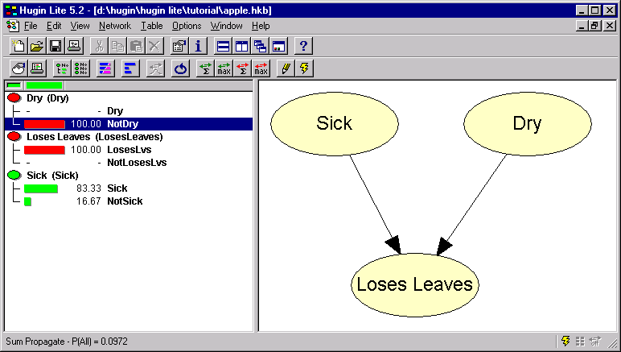
Probability of Dry set to 0
Probability of ‘Sick’ now much higher

Slide 10
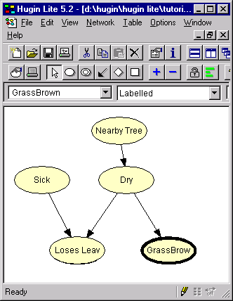
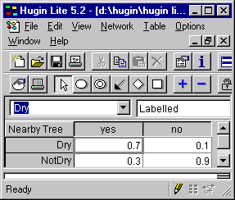
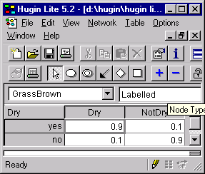
Add some Evidence for being dry

Slide 11
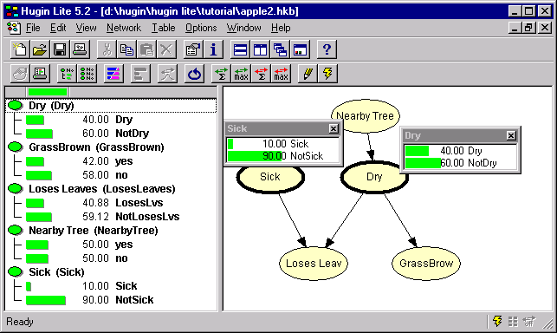
Initialize the Network
No information really on Leaves:
Just the ‘prior probability on everything

Slide 12
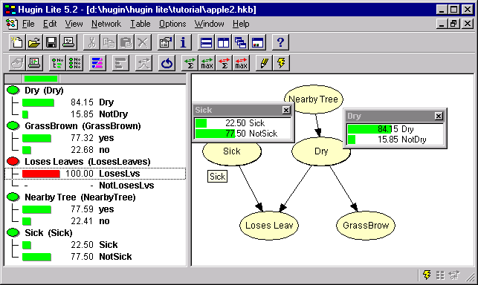
Now Set LosesLeaves to True
Probability of Dry and Sick both go up,
but Dry goes up much more.

Slide 13
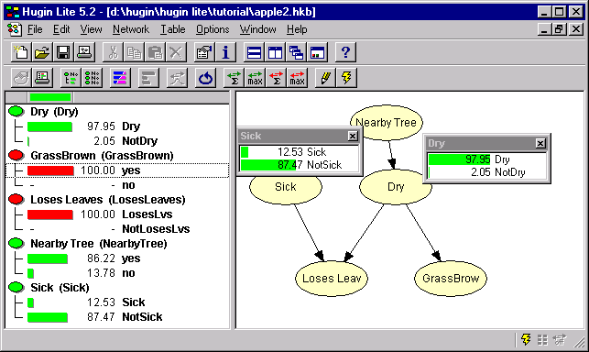
Now set GrassBrown to ‘yes’
Probability of Dry jumps to 97.95%
but look also at probability of NearbyTree

Slide 14
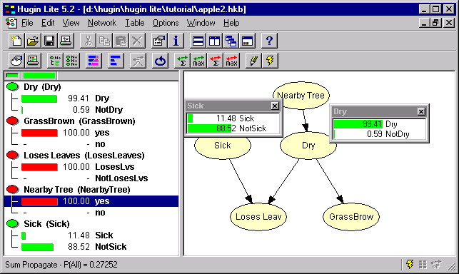
Say there is also a nearby tree
Unsurprisingly, the probability of Dry is nearly certain
The probability of Sick drops 10% or so

Slide 15
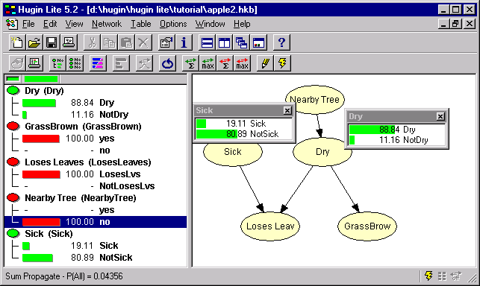
Even Consider there is no tree
The evidence of the brown grass is enough to
favor ‘Dry’ over ‘Sick’ by over 4:1

Slide 16
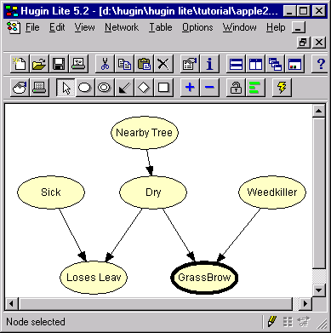
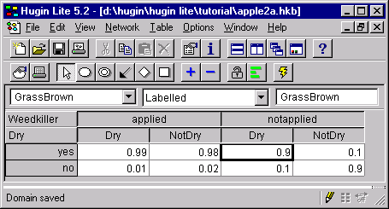
Evidence that is ‘Explained away’ is not evidence: consider...

Slide 17
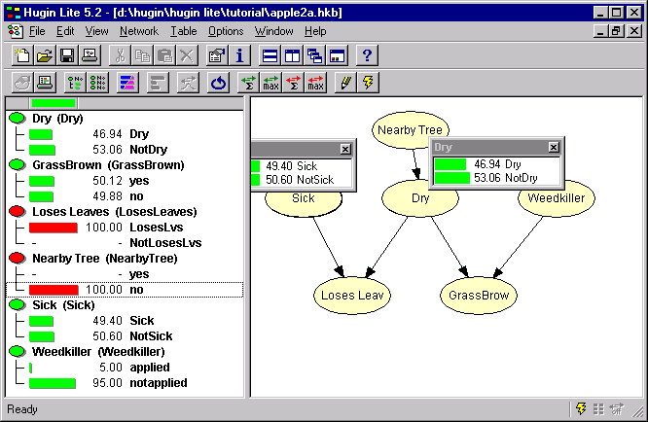
Losing Leaves, no nearby tree
Sick vs Dry roughly 50:50 (as before)

Slide 18
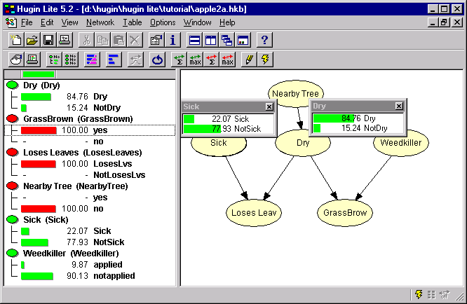
Add that the grass is brown
Odds in favour of Dry over Sick rise to 4:1 (84:22)

Slide 19
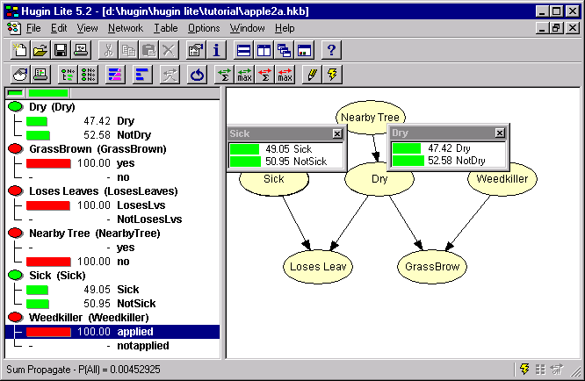
Now say that weedkiller was applied
The evidence from GrassBrown is explained away
Odds go back to 50:50

Slide 20
Diagnosis from Evidence and Diagnosis by Exclusion
Previous examples were diagnosis from evidence
  Normally evidence is a manifestation of the problem
    Dryness causes brown grass
    Sometimes we also reason from known causes, e.g.
    Nearby trees can add to dryness
Diagnosis of exclusion
  If there is evidence against all other causes, then the probability of what is left must rise
  Consider the next example…

Slide 21
Initialize the Network
No information really on Leaves:
Just the ‘prior probability on everything

Slide 22
Now Set LosesLeaves to True
Probability of Dry and Sick both go up,
but Dry goes up much more.

Slide 23
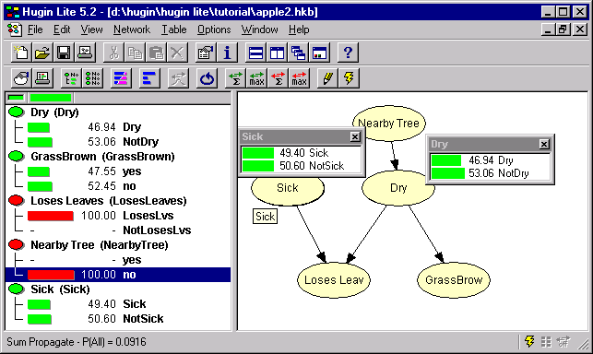
Now say there is no nearby tree
Probability of Sick goes up to 50:50
Probability of Dry falls to 50:50

Slide 24
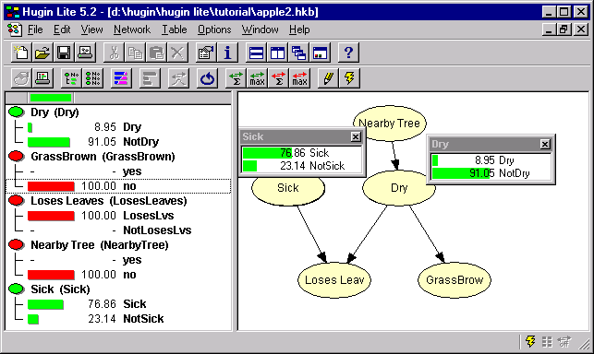
Now add that the grass is not brown
Probability of Dry falls to under 10%
Probability of Sick rises to 75%
‘Diagnosis of Exclusion’

